Slide 1
SEVEN SEGMENT DISPLAY
Kelompok I :
Muhammada Hafidzh 5022221069
Agatha Samuel Sitompul 5022221099
Priagung Ramadhan Alfalakhi 5022221161

Slide 2
DIAGRAM STATE SEVEN SEGMENT
00000
00001
00010
00011
00100
00101
00110
00111
00100
0
PADAM
1
PADAM
2
PADAM
3
PADAM
4
PADAM
10011
00101
PADAM
9
PADAM
8
PADAM
7
PADAM
6
PADAM
5
10010
10001
10000
01111
01110
01101
01100
01011
01010
TOTAL STATE : 20
JUMLAH D-FLIP-FLOP : 5 BUAH

Slide 3
TABEL INPUT D-FLIP FLOP
PRESENT STATE |  |  |  |  | NEXT STATE |  |  |  |  | INPUT Flip-Flop |  |  |  |  | Output 7-Segmen
V | W | X | Y | Z | V | W | X | Y | Z | Dv | Dw | Dx | Dy | Dz
0 | 0 | 0 | 0 | 0 | 0 | 0 | 0 | 0 | 1 | 0 | 0 | 0 | 0 | 1 | 0
0 | 0 | 0 | 0 | 1 | 0 | 0 | 0 | 1 | 0 | 0 | 0 | 0 | 1 | 0 | PADAM 1
0 | 0 | 0 | 1 | 0 | 0 | 0 | 0 | 1 | 1 | 0 | 0 | 0 | 1 | 1 | 1
0 | 0 | 0 | 1 | 1 | 0 | 0 | 1 | 0 | 0 | 0 | 0 | 1 | 0 | 0 | PADAM 2
0 | 0 | 1 | 0 | 0 | 0 | 0 | 1 | 0 | 1 | 0 | 0 | 1 | 0 | 1 | 2
0 | 0 | 1 | 0 | 1 | 0 | 0 | 1 | 1 | 0 | 0 | 0 | 1 | 1 | 0 | PADAM 3
0 | 0 | 1 | 1 | 0 | 0 | 0 | 1 | 1 | 1 | 0 | 0 | 1 | 1 | 1 | 3
0 | 0 | 1 | 1 | 1 | 0 | 1 | 0 | 0 | 0 | 0 | 1 | 0 | 0 | 0 | PADAM 4
0 | 1 | 0 | 0 | 0 | 0 | 1 | 0 | 0 | 1 | 0 | 1 | 0 | 0 | 1 | 4
0 | 1 | 0 | 0 | 1 | 0 | 1 | 0 | 1 | 0 | 0 | 1 | 0 | 1 | 0 | PADAM 5
0 | 1 | 0 | 1 | 0 | 0 | 1 | 0 | 1 | 1 | 0 | 1 | 0 | 1 | 1 | 5
0 | 1 | 0 | 1 | 1 | 0 | 1 | 1 | 0 | 0 | 0 | 1 | 1 | 0 | 0 | PADAM 6
0 | 1 | 1 | 0 | 0 | 0 | 1 | 1 | 0 | 1 | 0 | 1 | 1 | 0 | 1 | 6
0 | 1 | 1 | 0 | 1 | 0 | 1 | 1 | 1 | 0 | 0 | 1 | 1 | 1 | 0 | PADAM 7
0 | 1 | 1 | 1 | 0 | 0 | 1 | 1 | 1 | 1 | 0 | 1 | 1 | 1 | 1 | 7
0 | 1 | 1 | 1 | 1 | 1 | 0 | 0 | 0 | 0 | 1 | 0 | 0 | 0 | 0 | PADAM 8
1 | 0 | 0 | 0 | 0 | 1 | 0 | 0 | 0 | 1 | 1 | 0 | 0 | 0 | 1 | 8
1 | 0 | 0 | 0 | 1 | 1 | 0 | 0 | 1 | 0 | 1 | 0 | 0 | 1 | 0 | PADAM 10
1 | 0 | 0 | 1 | 0 | 1 | 0 | 0 | 1 | 1 | 1 | 0 | 0 | 1 | 1 | 9
1 | 0 | 0 | 1 | 1 | 0 | 0 | 0 | 0 | 0 | 0 | 0 | 0 | 0 | 0 | PADAM 11
D | Q | Q(+1)
0 | 0 | 0
0 | 1 | 0
1 | 0 | 1
1 | 1 | 1

Slide 4
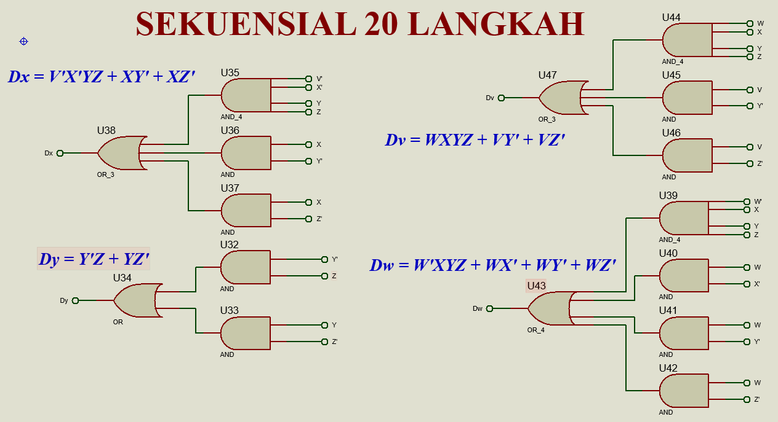

Slide 5
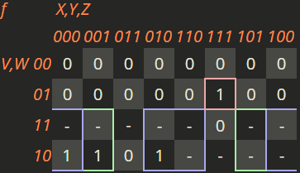
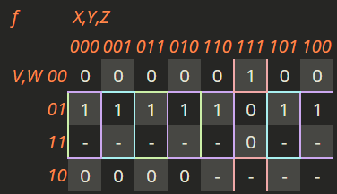
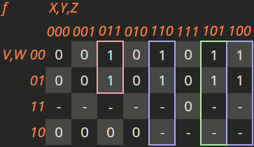
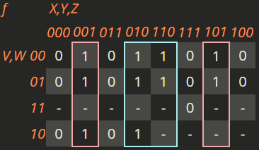
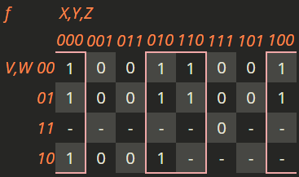
SUM OF PRODUCT
DV = WXYZ + VY' + VZ'
DW = W'XYZ + WX' + WY' + WZ'
DX = V'X'YZ + XY' + XZ'
DY = Y'Z + YZ'
DZ =Z'

Slide 6
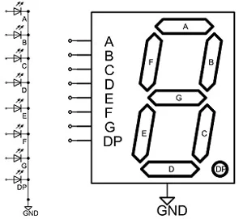
BINER KE SEVEN SEGMENT
m | V | W | X | Y | Z | ANGKA | A | B | C | D | E | F | G
0 | 0 | 0 | 0 | 0 | 0 | 0 | 1 | 1 | 1 | 1 | 1 | 1 | 0
1 | 0 | 0 | 0 | 0 | 1 | PADAM | 0 | 0 | 0 | 0 | 0 | 0 | 0
2 | 0 | 0 | 0 | 1 | 0 | 1 | 0 | 1 | 1 | 0 | 0 | 0 | 0
3 | 0 | 0 | 0 | 1 | 1 | PADAM | 0 | 0 | 0 | 0 | 0 | 0 | 0
4 | 0 | 0 | 1 | 0 | 0 | 2 | 1 | 1 | 0 | 1 | 1 | 0 | 1
5 | 0 | 0 | 1 | 0 | 1 | PADAM | 0 | 0 | 0 | 0 | 0 | 0 | 0
6 | 0 | 0 | 1 | 1 | 0 | 3 | 1 | 1 | 1 | 1 | 0 | 0 | 1
7 | 0 | 0 | 1 | 1 | 1 | PADAM | 0 | 0 | 0 | 0 | 0 | 0 | 0
8 | 0 | 1 | 0 | 0 | 0 | 4 | 0 | 1 | 1 | 0 | 0 | 1 | 1
9 | 0 | 1 | 0 | 0 | 1 | PADAM | 0 | 0 | 0 | 0 | 0 | 0 | 0
10 | 0 | 1 | 0 | 1 | 0 | 5 | 1 | 0 | 1 | 1 | 0 | 1 | 1
11 | 0 | 1 | 0 | 1 | 1 | PADAM | 0 | 0 | 0 | 0 | 0 | 0 | 0
12 | 0 | 1 | 1 | 0 | 0 | 6 | 1 | 0 | 1 | 1 | 1 | 1 | 1
13 | 0 | 1 | 1 | 0 | 1 | PADAM | 0 | 0 | 0 | 0 | 0 | 0 | 0
14 | 0 | 1 | 1 | 1 | 0 | 7 | 1 | 1 | 1 | 0 | 0 | 0 | 0
15 | 0 | 1 | 1 | 1 | 1 | PADAM | 0 | 0 | 0 | 0 | 0 | 0 | 0
16 | 1 | 0 | 0 | 0 | 0 | 8 | 1 | 1 | 1 | 1 | 1 | 1 | 1
17 | 1 | 0 | 0 | 0 | 1 | PADAM | 0 | 0 | 0 | 0 | 0 | 0 | 0
18 | 1 | 0 | 0 | 1 | 0 | 9 | 1 | 1 | 1 | 1 | 0 | 1 | 1
19 | 1 | 0 | 0 | 1 | 1 | PADAM | 0 | 0 | 0 | 0 | 0 | 0 | 0
20 | 1 | 0 | 1 | 1 | 0 |  | x | x | x | x | x | x | x
21 | 1 | 0 | 1 | 1 | 1 |  | x | x | x | x | x | x | x
22 | 1 | 0 | 1 | 1 | 1 |  | x | x | x | x | x | x | x

Slide 7
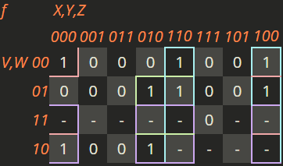
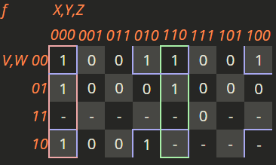
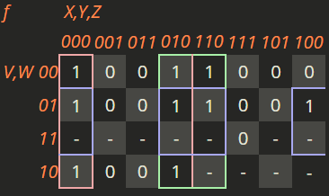
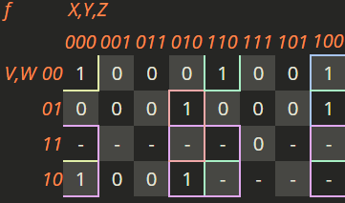
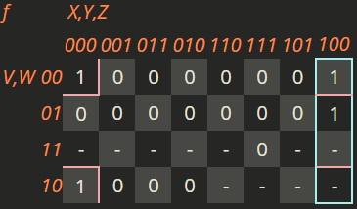
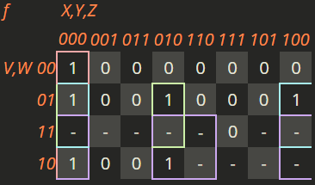
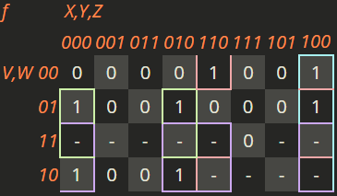
SUM OF PRODUCT
A = W'Y'Z' + XZ' + WYZ' + VZ'
B = W'Z' + X'Y'Z' + XYZ'
C = X'Z' + YZ' + WZ'
D = W'Y'Z' + W'XZ' + WX'YZ' + XY'Z' + VZ'
E = W'Y'Z' + XY'Z'
F = X'Y'Z' + WX'Z' + WY'Z' + VZ'
G = W'XZ' + WX'Z' + VZ' + XY'Z'

Slide 8
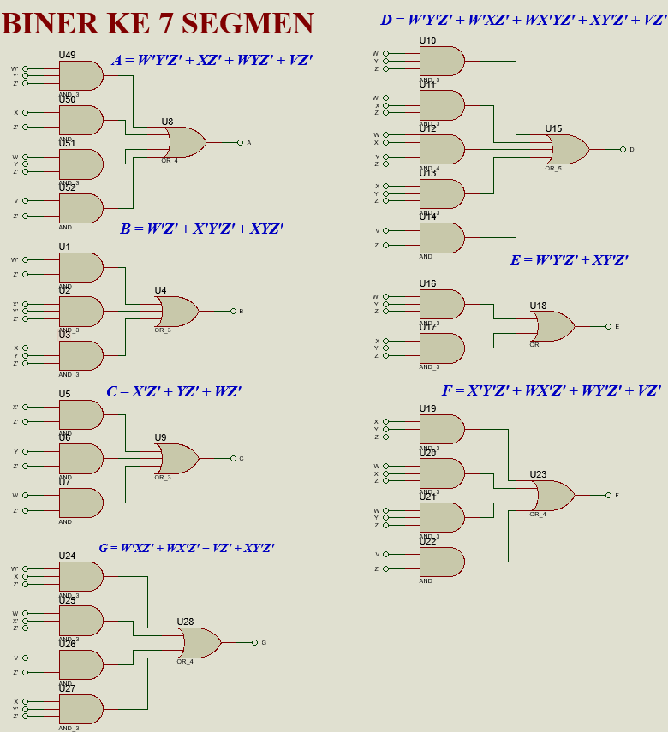

Slide 9
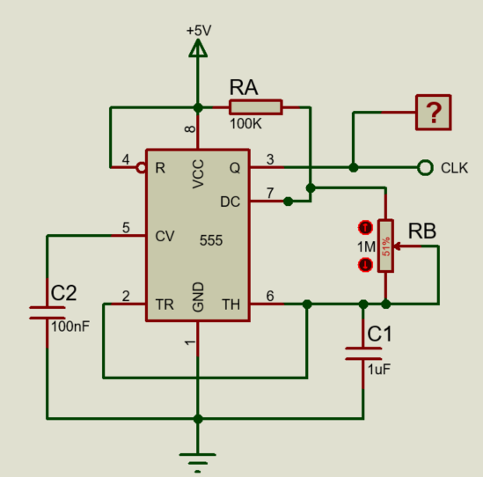
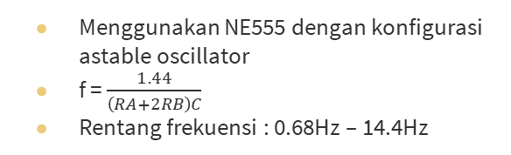
PERANCANGAN CLOCK
Menggunakan NE555 dengan konfigurasi astable oscillator
f = $\frac{1.44}{\left(RA+2RB\right)C}$
Rentang frekuensi : 0.68Hz – 14.4Hz

Slide 10
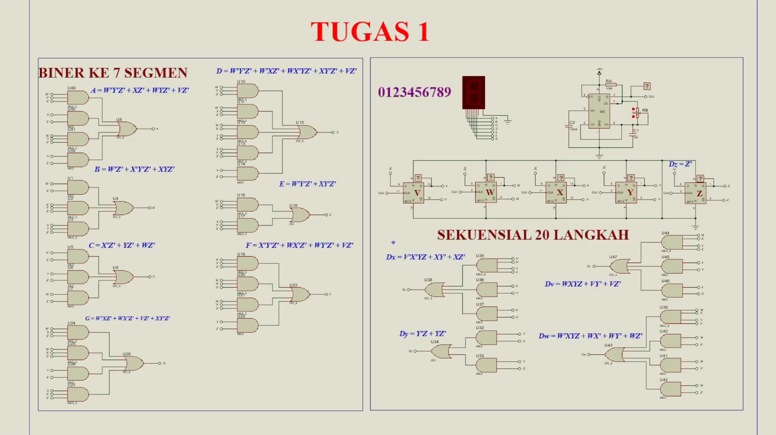
Terimakasih berikut demo simulasinya

